Slide 1
RWTY: R We There Yet?
Dan Warren

Slide 2
Heuristic Search (Likelihood)
Use a starting tree
Have a set of rules for improving the tree
Stop when no further improvements are possible
A B C D
Awesomeness
Tree topology

Slide 3
Heuristic Search (Likelihood)
Use a starting tree
Have a set of rules for improving the tree
Stop when no further improvements are possible
Awesomeness
Tree topology

Slide 4
Heuristic Search (Likelihood)
?
Use a starting tree
Have a set of rules for improving the tree
Stop when no further improvements are possible
Awesomeness
Tree topology

Slide 5
Heuristic Search (Likelihood)
Finished!
Use a starting tree
Have a set of rules for improving the tree
Stop when no further improvements are possible
Awesomeness
Tree topology

Slide 6
Heuristic Search (Likelihood)
Local optima are a HUGE problem here
Awesomeness
Tree topology

Slide 7
Heuristic Search (Likelihood)
Local optima are a HUGE problem here
Finished!
Awesomeness
Tree topology

Slide 8
Why is this so hard?
Data is noisy
The number of possible trees is often HUGE
Finding the next move can be computationally expensive
Awesomeness
Tree topology

Slide 9
Why is this so hard?
Tree space is NOT necessarily smooth
Awesomeness
…but in a space with zillions of dimensions

Slide 10

MCMC
MCMC $≠$ Bayes
MCMC is a method of approximating very high-dimensional probability distributions – a method of exploring treespace that is fundamentally different from heuristic searches
Awesomeness

Slide 11
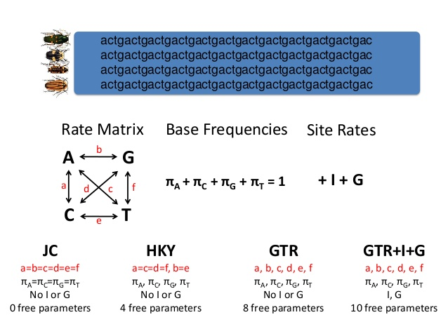
MCMC
We have a starting tree, model of evolution, and branch lengths
A B C D

Slide 12
MCMC
We calculate the posterior probability of those estimates based on our data and a set of priors
+
A B C D
given
= LnL or pp

Slide 13
MCMC
Propose a change (e.g., to model parameters, topology, or branch lengths)
A B C D
B A C D

Slide 14
MCMC
We calculate the posterior probability of those estimates based on our data and a set of priors
+
B A C D
given
= new LnL or pp

Slide 15
Taking a step
If new probability > old probability, take the step
If new < old, maybe take the step anyway
Probability of taking the step is determined by how much worse the new solution is
Definitely take the proposed step
High probability to take the proposed step
Low probability to take the proposed step
Posterior Probability
old
new
old
new
old
new

Slide 16
MCMC
Do this enough times and you will ultimately visit every solution in proportion to its posterior probability
Awesomeness
Tree topology

Slide 17
MCMC
1
2
3
4
5
6
7
8
9
10
11
12
Do this enough times and you will ultimately visit every solution in proportion to its posterior probability

Slide 18
Why MCMC?
Phylogenetic implementations are Bayesian
Can be MUCH faster
Allows more complicated models
Can go downhill
Measures uncertainty
Awesomeness
Tree topology

Slide 19
Key point
The goals of heuristic search and MCMC are fundamentally different
Heuristic
MCMC
Awesomeness
Awesomeness

Slide 20
To put it another way
Heuristic search asks “what’s the best solution I can get from this set of assumptions?”
MCMC asks “what does the set of good solutions have in common?”
Awesomeness
Awesomeness
Tree topology
Tree topology

Slide 21
The big problem
MCMC has no predefined stopping point
Awesomeness
Tree topology

Slide 22
Convergence
Do we need to visit all solutions?
How many DO we need to visit?
Awesomeness
Tree topology

Slide 23
R WE THERE YET?

Slide 24
Convergence
How do we know when further exploration of the solution space does not change the answer?
By tracking the set of solutions over time and seeing if they’re still changing
Awesomeness
Tree topology

Slide 25
What do we have?
A B C D
= LnL
All of these are changing except the data

Slide 26
What do we have?
If one of these has stopped changing, does that mean the others have?
A B C D
= LnL

Slide 27
Necessary and sufficient conditions
A necessary condition for diagnosing convergence would be of the form “if the chain has reached convergence, we would see behaviour X”
A sufficient condition for diagnosing convergence would be of the form “if we see behaviour X, that implies that the chain has reached convergence”

